Slide 1

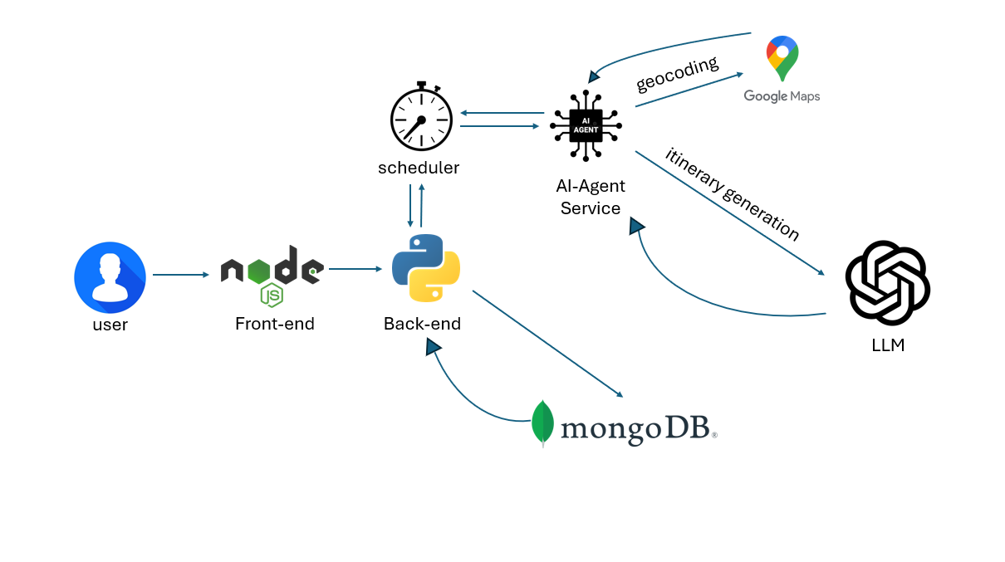




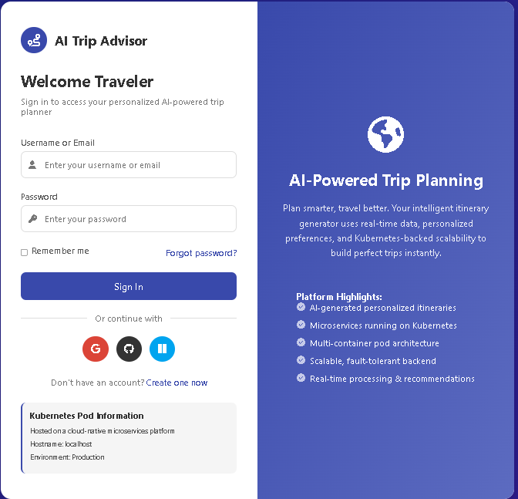
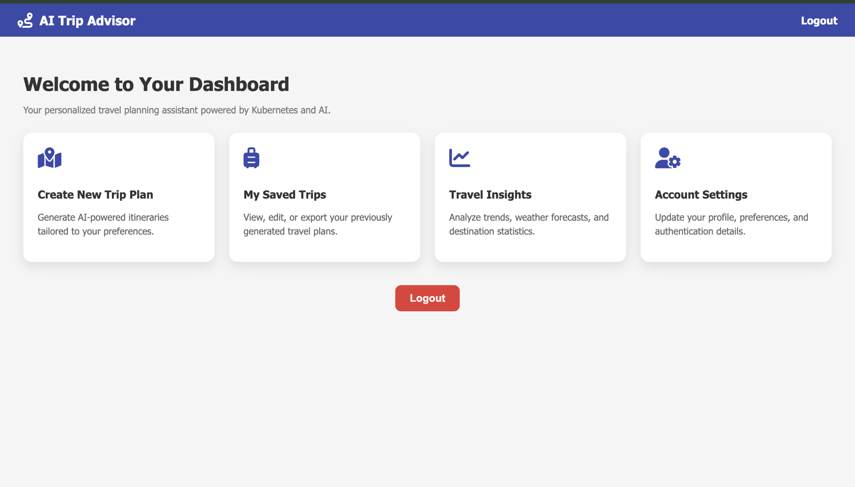
Scan Here for Github Repository:
AI Trip Advisor: Cloud-Native Travel Planning Platform
Sultan Fahim, James McKim, Karan Khademi, Will Huff, Clinton Ugwuanyi
Department of Computer Science, West Chester University of Pennsylvania
The AI Trip Advisor platform represents a revolutionary approach to travel planning by leveraging cloud-native technologies and artificial intelligence. Built on Kubernetes with a microservices architecture, the system transforms raw travel preferences into comprehensive, personalized itineraries within seconds. The platform demonstrates advanced cloud engineering concepts including multi-container pods, service orchestration, and automated scaling, providing a scalable foundation for intelligent travel planning that adapts to user demands in real-time.

